Slide 1
The long and tragedy-filled dramatic tale of our Reinforcement Learner
Also known as, I'm never ever having kids: A Multi-Part Series
By Donovan, Serena, and Lucille

Slide 2
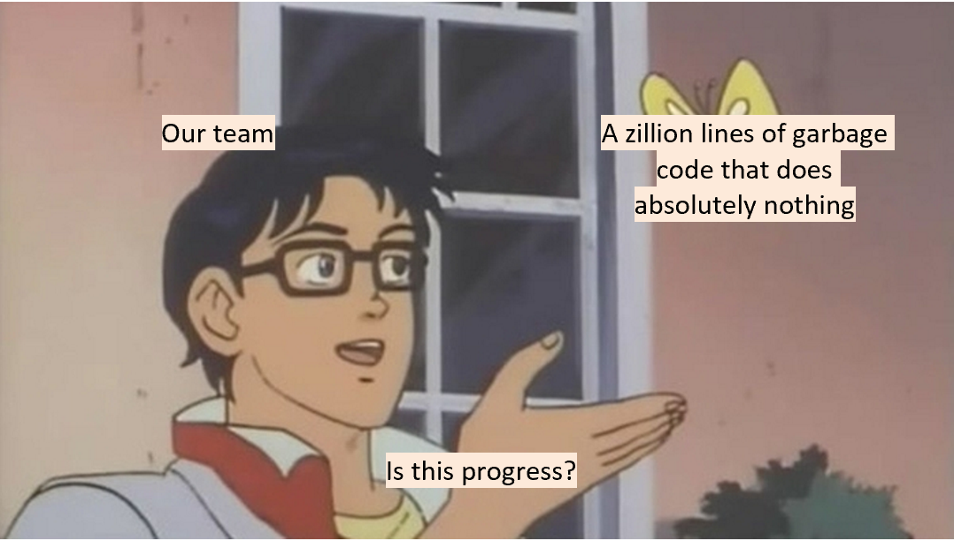
So it didn’t go well for like six straight days...
Notes:
Serena

Slide 3
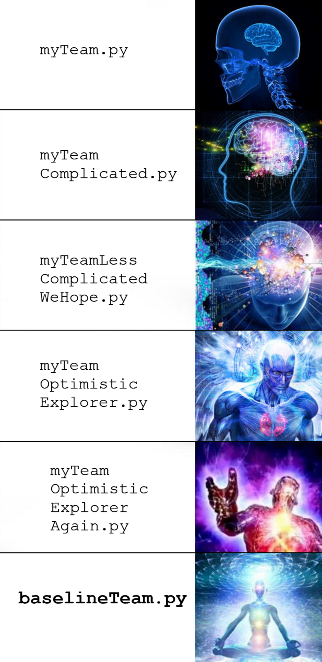
We had a lot of trial and error
A lot.
Notes:
Serena

Slide 4
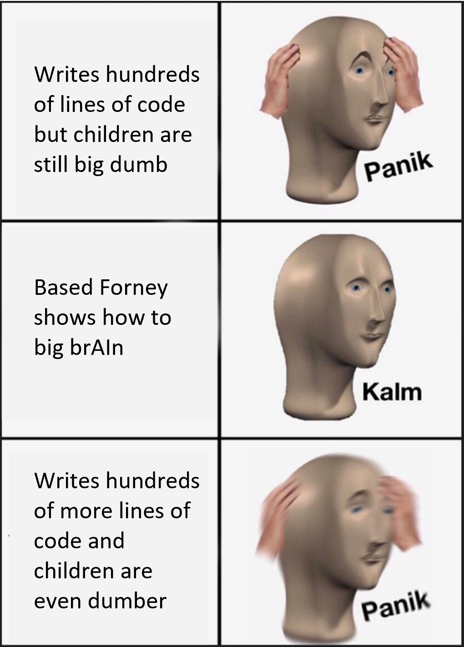
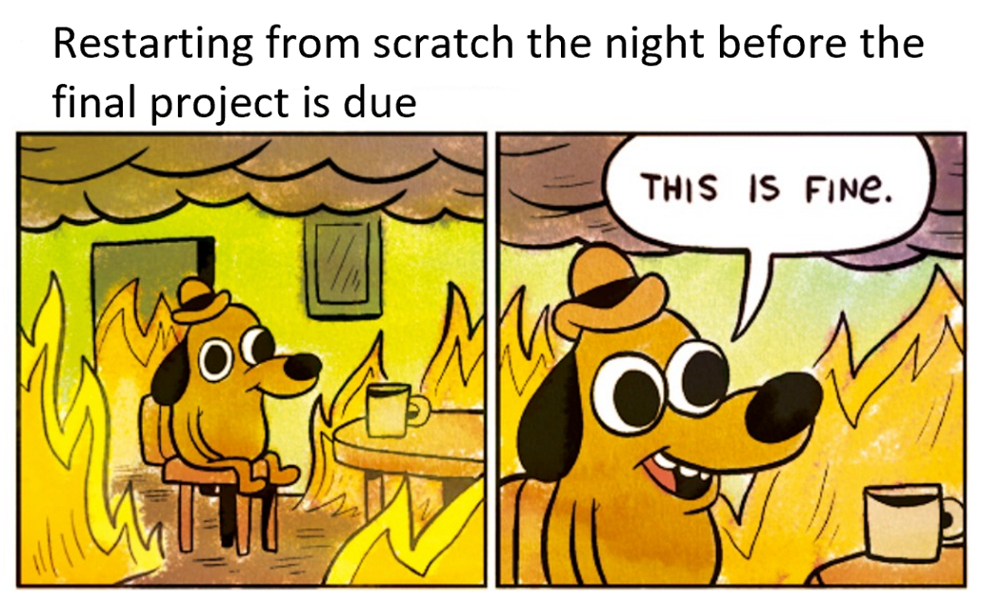
It seemed that all hope was lost...
... but then Forney gave us an extension and was amazing and helped us out a lot
Notes:
Lucille

Slide 5
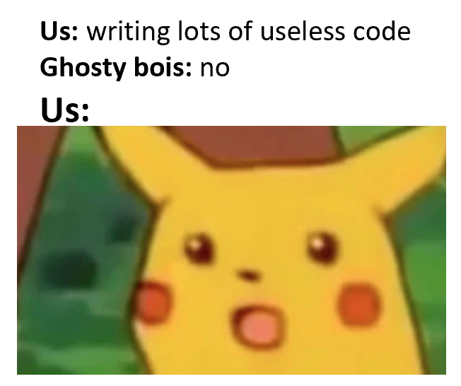
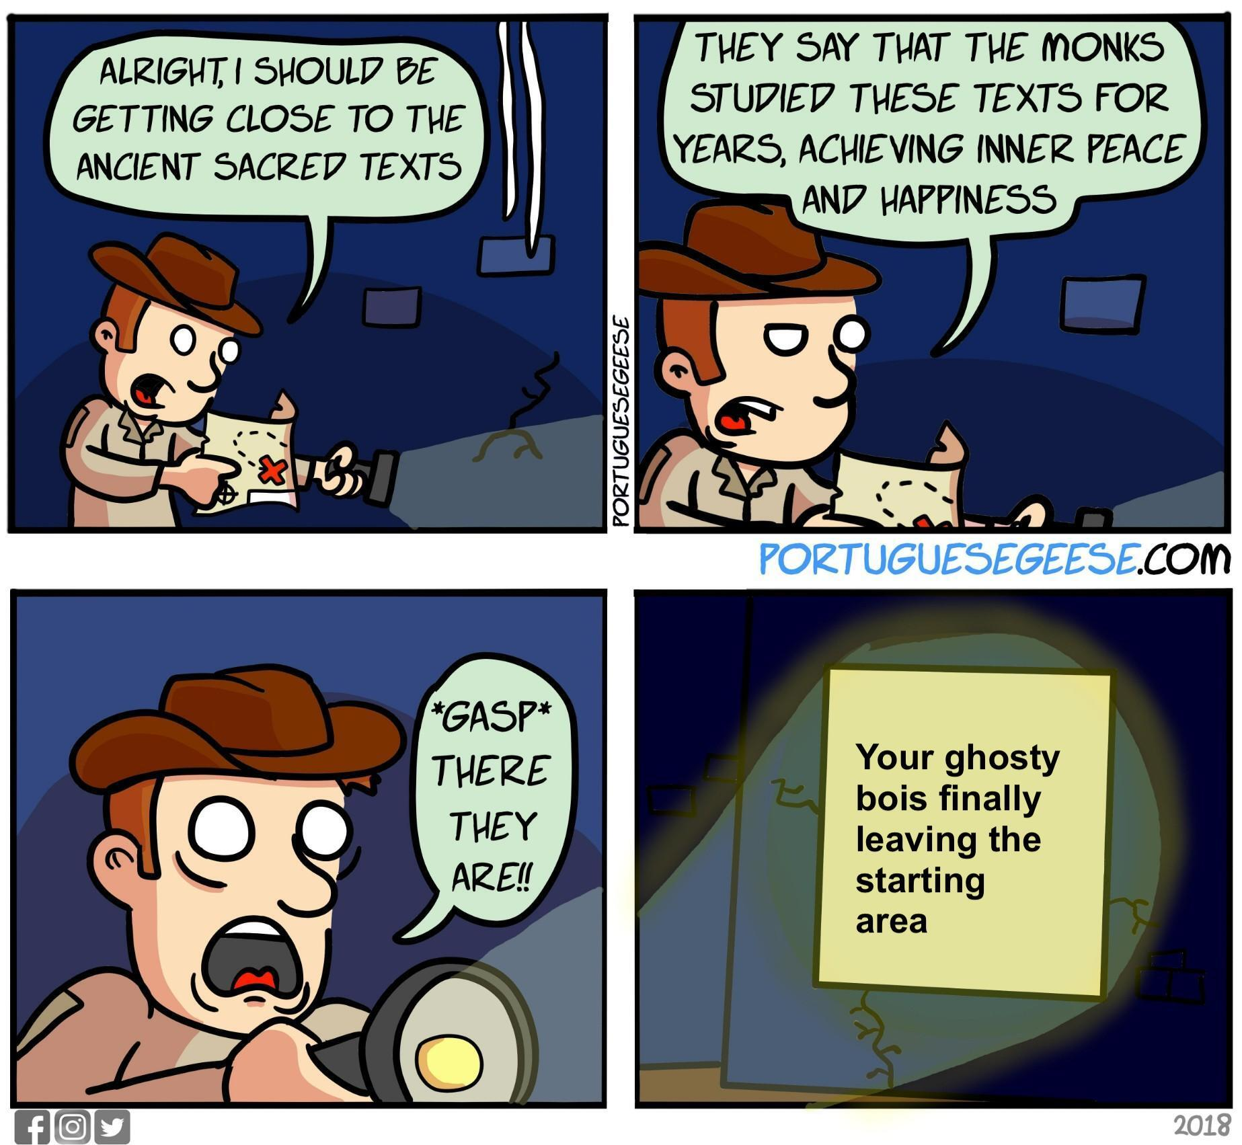
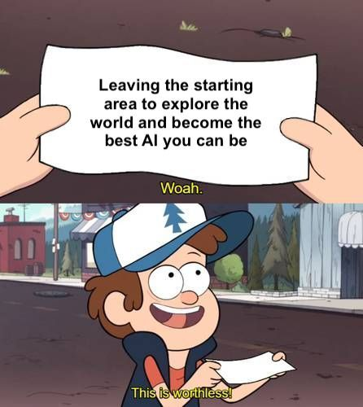
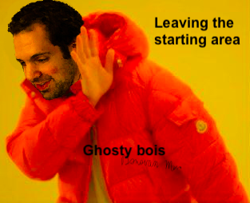
Overall Strategies
The Hungry Hungry (Careful) HippoTM Approach
Greed for food, but tempered by caution
Balancing the risk of having pellets and being on the opponent's side with the reward of having pellets
The more food we're carrying and the farther we venture into enemy territory, the more incentive to get back to safety
Coordination: Adopted the baseline agent
Notes:
Serena

Slide 6
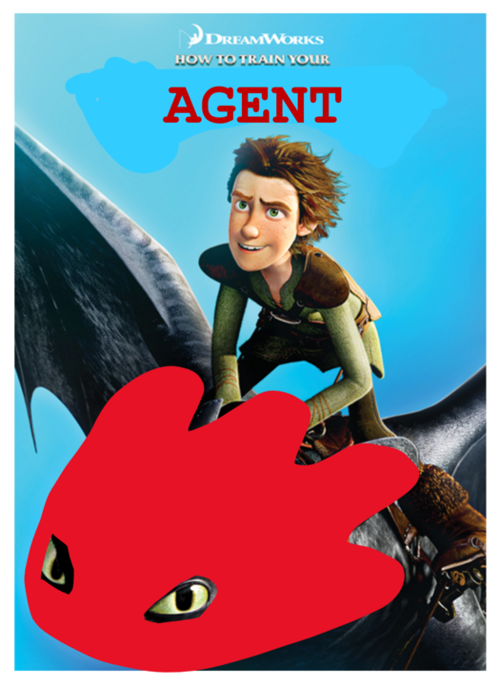
How to Train Your Agent
Optimistic Sampling
Added a "curiosity bias" to vanilla Q-values such that states that had not been explored as much had higher values
Result is high incentive to explore states that we haven’t experienced yet
Pros: Ghosty Boi learns a lot about the map and is willing to try a lot of things, so it gathers a lot of useful information
Cons: It is very, very dumb in the beginning and got its butt kicked at first
High loss high reward
Trained on >250 matches before we started winning
Notes:
Lucille

Slide 7
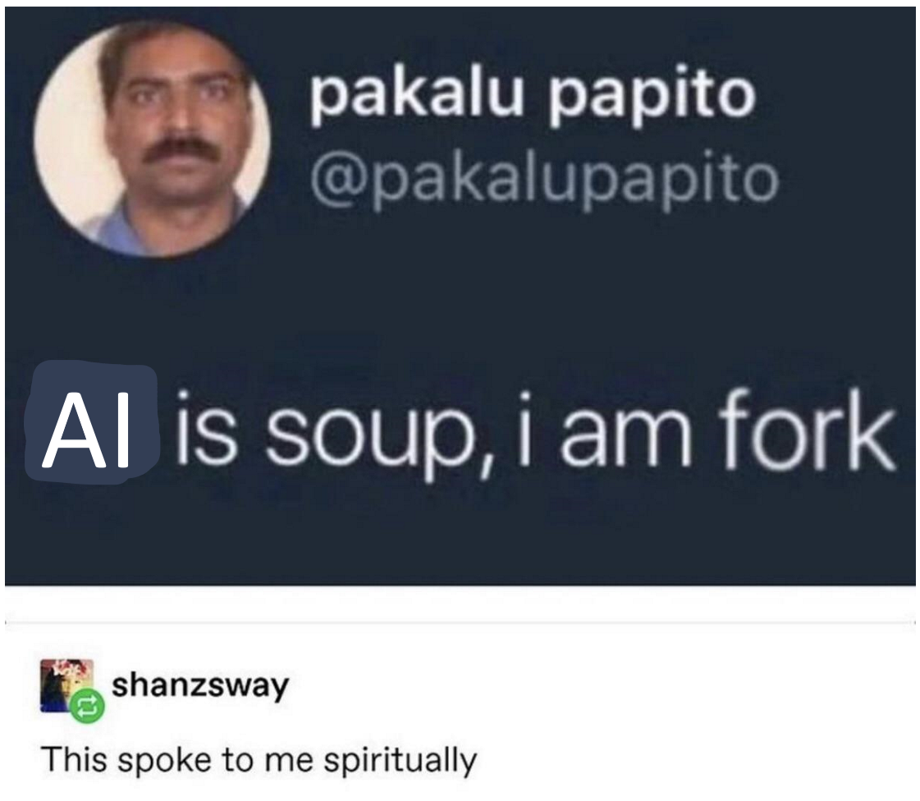
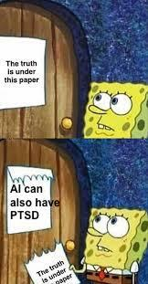
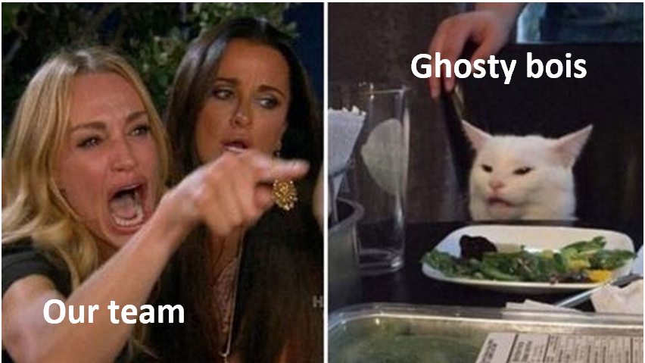
Our Reward Functions
Dying = Very Big Bad; penalty of -500
Eating = Good -- but only if we're not carrying too many pellets
+10 if we're not carrying any pellets yet
...but if we have already collected pellets, give a penalty that scales up as we collect more
Honestly Mood
Notes:
Donovan

Slide 8
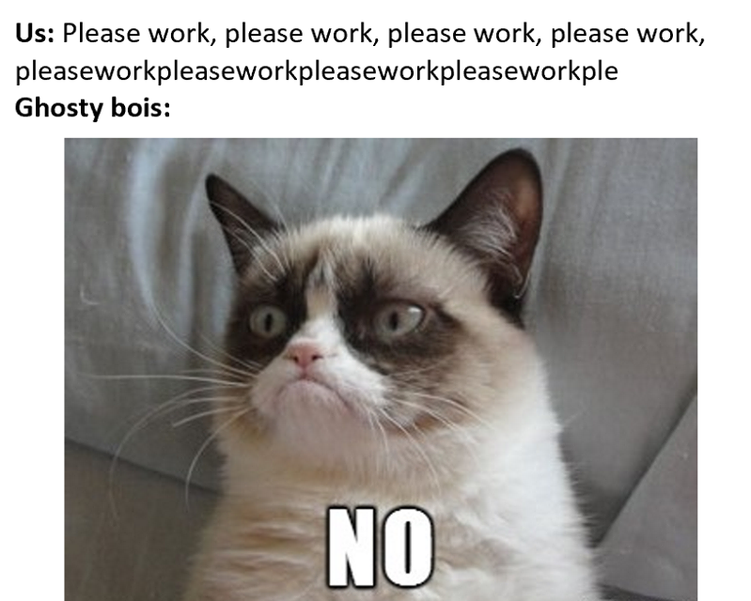
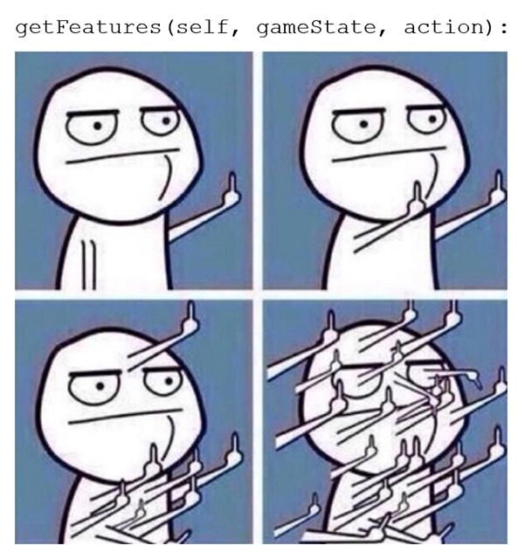
Features We Chose
Distance to Nearest Food
Only relevant when enemy is not close by -- further than 5 moves away
Distance to Nearest Enemy
Only relevant when our agent is killable (we're on opponent side, not powered up, and enemy is close by)
Avoiding Dead Ends
When on opponent side, consider how many walls there are surrounding a given location to avoid dead-end traps
Safety
A desire for safety that is a function of both the number of pellets we are carrying times nearest distance to own side
Bias
Always set to 0.1 for stabilizing weights
Notes:
Donovan

Slide 9
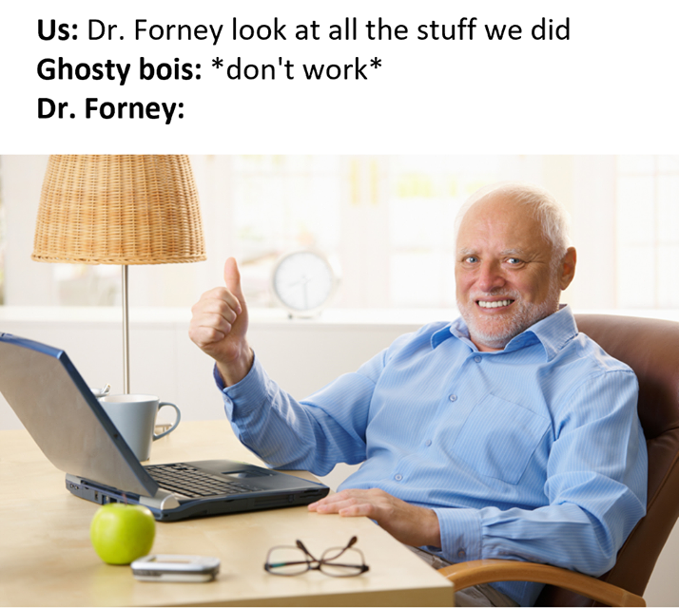
Thank you SO much Dr. Forney!

Slide 10
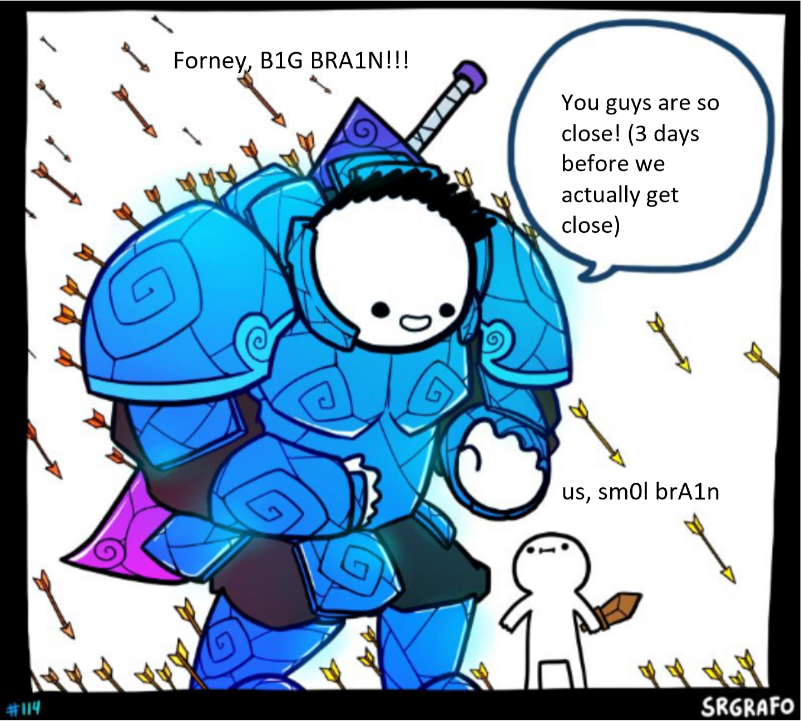
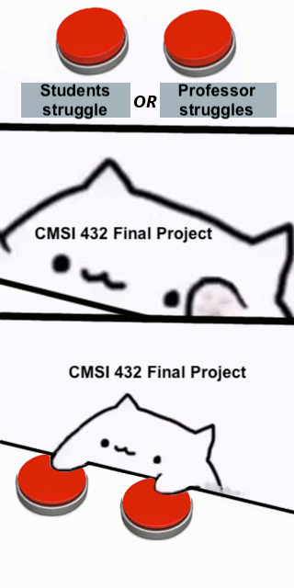
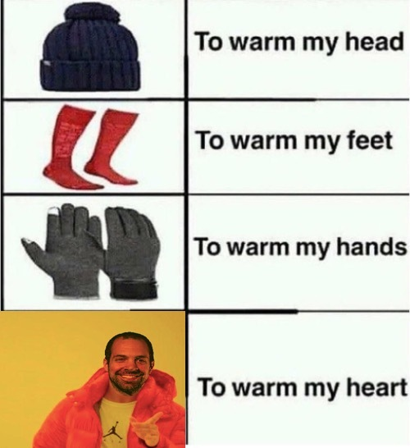

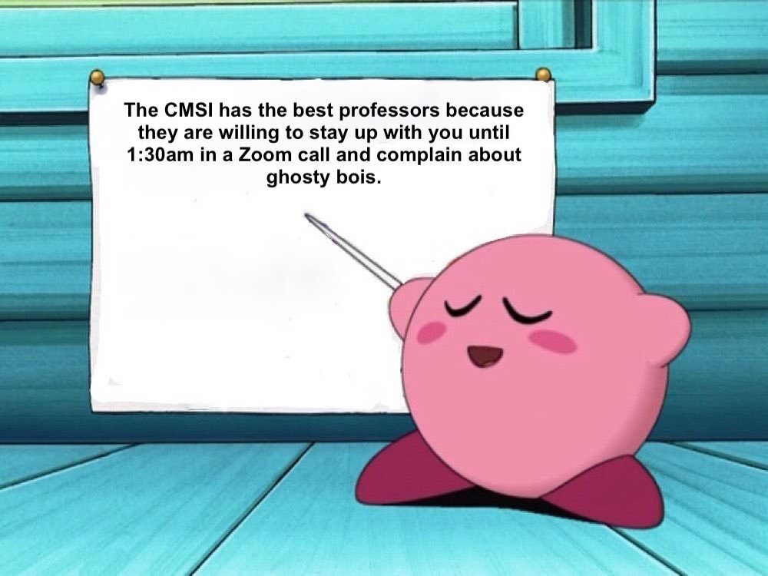
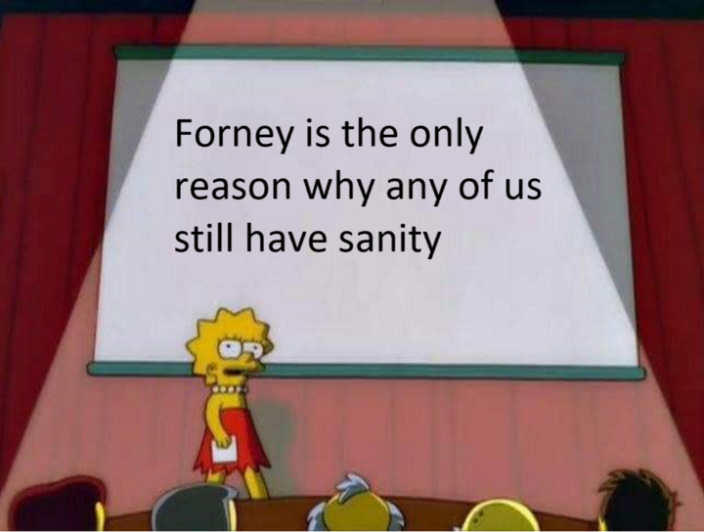
Forney Appreciation Page

Slide 11
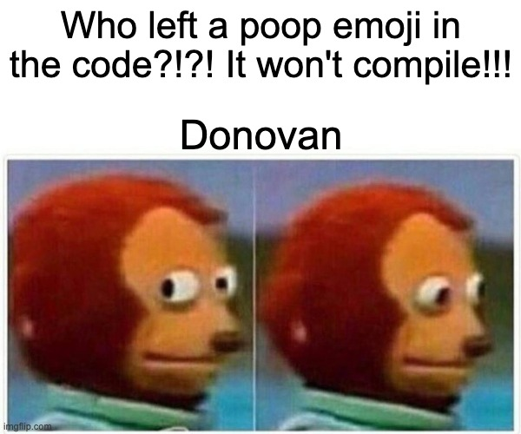
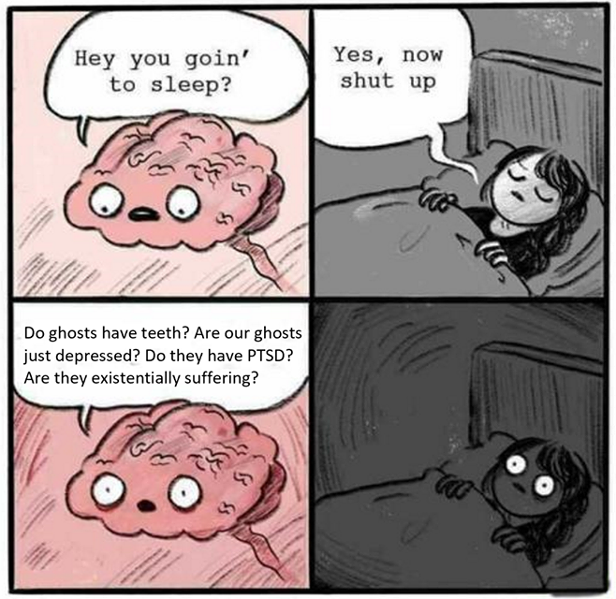


The end
Notes:
Donovan

